Slide 1


Session 6: Inventories
Financial Analysis
BBA FinTech, 2nd year
2026
Eric Maton

Slide 2
Sessions 1 and 2
Basic business equation or fundamental accounting equation (balance sheet represented as an equation)
Sessions 3 and 4
Income statement (or P&L: profit and loss account): from accounting information to financial analysis
Brief contents
Session 5 and 6
Non-current assets (P,P&E, intangible assets and right-of-use assets) and current assets (inventories)

Slide 3
Session 7
Financial analysis techniques:
Activity ratios, solvency ratios and liquidity ratios
Brief contents
Sessions 8 and 9
Statement of cash flows (operating cash flows, investing cash flows and financing cash flows) and revision

Slide 4
Grade
10% Midterm exam 1: MCQ on Blackboard at the beginning of session 4 (Tuesday 24 March) (30 minutes) with simple calculator
20% Midterm exam 2: MCQ on Blackboard at the beginning of session 7 (Tuesday 31 March) (1 hour) with simple calculator
10% Attendance
60% Final examination: 3 exercises (2 hours) (April 29, 14:30-16:30)

Slide 5
Inventories

Slide 6
Current (operating) Assets IAS 2 - Inventories
“Inventories are assets:
(a) Held for sale in the ordinary course of business;
(b) In the process of production for such sale; or
(c) In the form of materials or supplies to be consumed in the production process or in the rendering of services”
Held for usage: P,P&E
Current assets
Manufacturing company
Raw material inventory
Work in progress inventory
Finished goods inventory
Notes:
(a) détenus en vue de la vente dans le cours normal de l’activité ;
(b) en cours de production pour une telle vente ; ou
(c) sous forme de matières premières ou de fournitures devant être consommées dans le processus de production ou de prestation de services »

Slide 7
Measurement of inventories at their entry date
Inventories shall be measured at the lower of cost and net realizable value (estimated selling price less costs of completion necessary to make the sale) at their acquisition date (under IFRS).
The cost of a stock includes the following:
Other costs incurred in bringing the inventories to their present location and condition
Cost of an inventory
Acquisition cost
Cost of conversion
=
+
+
Acquisition cost
=
Purchase price
import duties
Taxes non recoverable
Transport, handling
Trade discounts, rebates and other similar items are deducted
Cost of conversion
=
costs directly related to the units of production, such as direct labour
Systematic allocation of fixed and variable production overheads: depreciation of factory, cost of factory management and administration…
Notes:
Conversion = transformation
Recoverable = récupérable
Net realisable value is the estimated selling price in the ordinary course of business less the estimated costs of completion and the estimated costs necessary to make the sale.

Slide 8
From purchases to the cost of sales in P&L
Components inventory
Components purchases including all expenses needed to have components available in inventory
P&L
Sales revenue
Cost of sales
Gross profit
S,G&A expenses
Operating profit
End.
Inv.
Op.
Inv.
Components used for production
bikes inventory
Ebikes (FG) inventory
Other manufacturing cost
bikes purchases including all expenses needed to have bikes available in inventory
Cost of goods manufactured (COGM)
Ending
Inventory
End.
Inv.
Op.
Inv.
bikes used for production
Cost of goods sold (COGS)
Opening
Inventory
Op. inv.: opening inventory, End. Inv.: ending inventory

Slide 9
P&L equations
Components used for production (outflow from components inventory) = Components purchased during the period (inflow from components inventory) + Opening components inventory – Ending components inventory
COGS (ebikes sold) (outflow from ebikes inventory) = COGM (ebikes produced during the period) (inflow from ebikes inventory) + Opening ebikes inventory – Ending ebikes inventory
Cost of sales (or cost of revenue) = Cost of goods sold (goods produced and sold by the company and goods purchased and directly sold by the company) + Direct cost of services rendered
Gross profit or gross margin = Revenue from sale of services and goods minus cost of sales

Slide 10
Measurement of inventories at their entry date
“Costs of purchase”
“The costs of purchase of inventories comprise:
the purchase price,
import duties
and other taxes (other than those subsequently recoverable by the entity from the taxing authorities), and
transport, handling and other costs directly attributable to the acquisition of finished goods, materials and services.
Trade discounts, rebates and other similar items are deducted in determining the costs of purchase”.
excluding VAT

Slide 11
Measurement of inventories at their entry date
“ Costs of conversion”
“The costs of conversion of inventories include :
costs directly related to the units of production, such as direct labour.
They also include a systematic allocation of fixed and variable production overheads that are incurred in converting materials into finished goods (…)
The allocation of fixed production overheads to the costs of conversion is based on the normal capacity of the production facilities”.
Rational allocation of fixed expenses (cost of under-activity which can not be attributed to inventory)
Notes:
Le coût de transformation des stocks comprennent les coûts directement liés aux unités produites, tels que la main-d’œuvre directe. Ils comprennent également l’affectation systématique des frais généraux de production fixes et variables qui sont engagés pour transformer les matières premières en produits finis (…)
L’affectation des frais généraux fixes de production aux coûts de transformation est fondée sur la capacité normale des installations de production ».
=> Imputation rationnelle des charges fixes (coût de sous-activité qui ne peut être imputé au stock)

Slide 12
Rational allocation of fixed costs
Normal activity: production of 100,000 products per month
Normal monthly production costs:
- €5 of unit variable cost
- €400,000 of fixed production overheads
Actual production in February 2026: 50,000 products
What is the value of an inventory of 30,000 products manufactured in February 2026?
What is the cost of production (i.e. COGS) to retain in the income statement in February 2026?
Notes:
Calculez le coût unitaire de production
How much does it cost to produce in December?
400 000 + 5€ x 50 000 = 650 000
Value of inventories at December 31, 19
30 000 x 9€ = 270 000
Débit Crédit
#6XXX 650 000
Bank 650 000
#2xxx 270 000
#603 270 000

Slide 13
Rational allocation of fixed costs
Unit production cost in normal activity: €5 + [€400,000 / 100,000 products] = €9
Unit production cost in February 2026: €5 + [€400,000 / 50,000 products] = €13
February production cost: €5 x 50,000 + €400,000 = €650,000 (COGM)
Valuation of Inventories at the end of February: €9 x 30,000 = €270,000
Accounting entries for February for the production
Cost of production (P&L) |  | 650,000
Cash or Payables (BS) |  |  | 650,000
Accounting entries for February for the inventories
Inventories (BS) |  | 270,000
Cost of production (P&L) |  |  | 270,000
Cost of goods sold (COGS) = 650,000 – 270,000 = 380,000
= 13 x 20,000 (sales vol.) + (13 – 9) (or 8 – 4: unit fixed cost) x 30,000 (excess of valuation not included in ending inventory)
Notes:
Cost of under-activity is not taken into account in the cost of inventories but must be taken into account in the amount of production cost recognised in the P&L.
1- The value of inventories manufactured in December 2019: you estimate this value according the unit production cost in normal activity. You do not take into account the under-activity
Dans le P&L final, on comptabilise la valeur des stocks au 31,12. Si on évalue ces stocks à 13€, on aura un impact positif dans le P&L en contrepartie (grâce au crédit de la variation de stock) qui sera supérieur.

Slide 14
Measurement of inventories at their entry date
“Other costs”
Other costs are included in the cost of inventories only to the extent that they are incurred in bringing the inventories to their present location and condition. For example, it may be appropriate to include non-production overheads or the costs of designing products for specific customers in the cost of inventories”.
Ability to include non-production costs (even financial costs according to IAS 23)
Notes:
Les autres coûts ne sont inclus dans le coût des stocks que dans la mesure où ils sont engagés pour amener les stocks à l’endroit et dans l’état où ils se trouvent. Par exemple, il peut être approprié d’inclure dans le coût des stocks des frais généraux autres que ceux de production ou les coûts de conception de produits à l’usage de clients spécifiques ».
=> Possibilité d’inclure des coûts hors production (voire aussi des coûts financiers si c’est un « actif éligible » au sens de la norme IAS 23)

Slide 15
Measurement of inventories at their entry date
“Examples of costs excluded from the cost of inventories and recognised as expenses in the period in which they are incurred are:
(a) abnormal amounts of wasted materials, labour or other production costs ;
(b) storage costs, unless those costs are necessary in the production process before a further production stage;
(c) administrative overheads that do not contribute to bringing inventories to their present location and condition; and
(d) Selling costs.”
Notes:
« Exemples de coûts exclus du coût des stocks et comptabilisés en charges de la période au cours de laquelle ils sont engagés :
(a) montants anormaux de déchets de fabrication, de main-d’œuvre ou d’autres coûts de production ;
(b) coûts de stockage, à moins que ces coûts soient nécessaires au processus de production préalablement à une nouvelle étape de la production ;
(c) frais généraux administratifs qui ne contribuent pas à amener les stocks à l’endroit et dans l’état où ils se trouvent ; et
(d) frais de commercialisation. »

Slide 16
From purchases to the cost of sales in P&L
Components inventory
P&L (with operating expense by function)
Sales revenue
Cost of sales (including all storage cost of ebikes)
Gross profit
S,G&A expenses = period cost
Operating profit
Components purchases including all expenses needed to have components available in inventory
Components used for production (including all storage cost of components)
End.
Inv.
Op.
Inv.
bikes inventory
Ebikes (FG) inventory
Other manufacturing cost
bikes purchases including all expenses needed to have bikes available in inventory
Cost of goods manufactured (COGM)
Ending
Inventory
End.
Inv.
bikes used for production (including all storage cost of bikes)
Op.
Inv.
Cost of goods sold (COGS)
Opening
Inventory
Op. inv.: opening inventory, End. Inv.: ending inventory

Slide 17
MCQ n°1
Inventory cost is least likely to include:
production-related storage costs.
costs incurred as a result of normal waste of materials.
transportation costs of shipping inventory to customers.

Slide 18
MCQ n°2
Mustard Seed PLC adheres to IFRS. It recently purchased inventory for €100 million and spent €5 million for storage prior to selling the goods. The amount it charged to inventory expense (€ millions) was closest to:
€95
€100
€105

Slide 19
Period versus product cost
Period cost = included in income statement (example: commercial expense and administrative expense)
Product cost: it depends how is used the product (product sold: product cost in income statement, product kept: product cost in inventory)

Slide 20
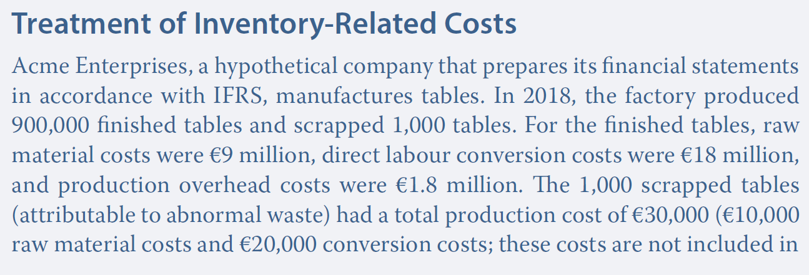
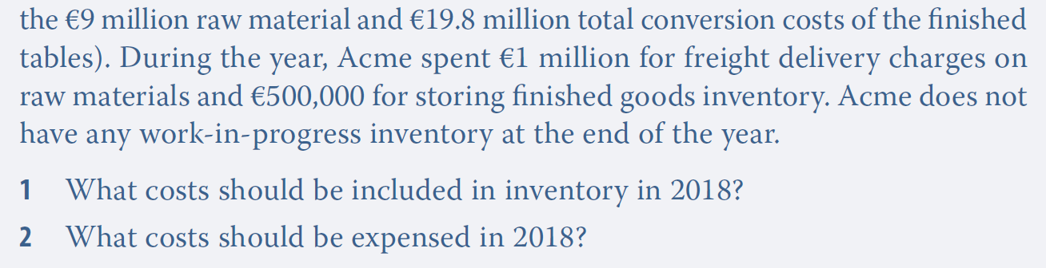
Measurement of inventories

Slide 21
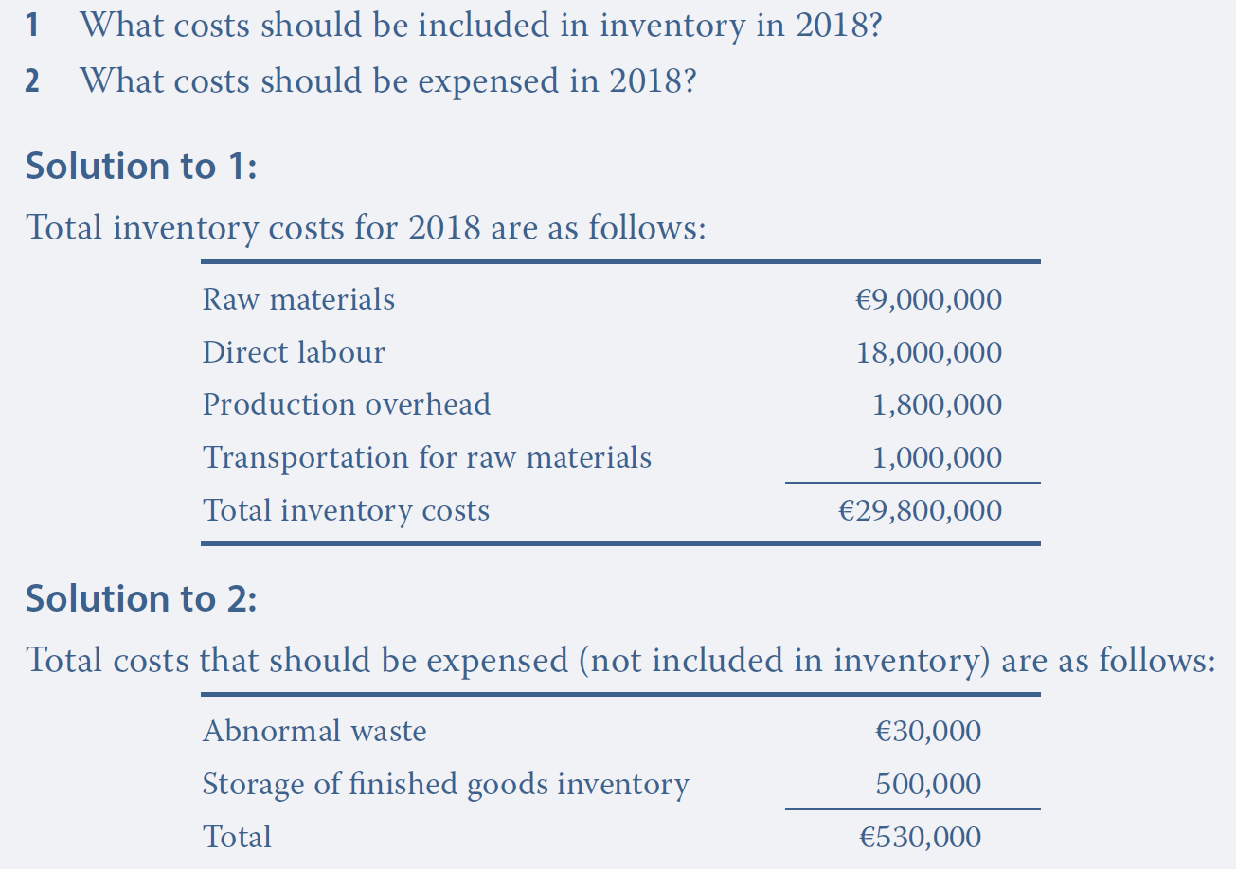
Measurement of inventories

Slide 22
Measurement of inventories after recognition FIFO, LIFO and average cost methods applied to merchandise (goods not produced by the firm ≠ finished goods)
Opening merchandise inventory:
30,000 units with a unit purchase cost of $5
Purchases during the period:
20,000 units with a unit purchase cost of $8
Quantity checked in ending inventory:
10,000 units
What is the cost of goods sold (COGS) and the ending inventory value with the three methods (FIFO, LIFO, (weighted) average (unit) cost)?

Slide 23
Measurement of inventories after recognition FIFO, LIFO and average cost methods applied to merchandise (goods not produced by the firm ≠ finished goods)
Merchandise inventory
 | Quantity | Unit cost
Opening inventory
Purchases
COGS | 40,000
Ending inventory
Available Inventory =
30,000
$5
$310,000
20,000
$8
?
Depends on the chosen method
10,000
?
By deduction:
30,000 + 20,000 = 50,000 (available inventory in volume)
50,000 – 10,000 = Outflow (merchandise sold volume)
Notes:
1) Quantity of Opening inventory : 30,000
2) Quantity of Purchases : 20,000
3) Quantity of ending Inventory : 10,000
4) By deduction, the quantity of COGS is: 30 000 + 20 000 – 10 000 = 40 000
5) What is the unit cost of opening inventory ? $5
6) What is the unit cost of purchases ? $8
7) What is the total amount of the available inventory: 30 000 x 5$ + 20 000 x 8$ = 310 000 $
8) What is the unit cost of COGS and Ending Inventory => depending on the chosen method

Slide 24
Measurement of inventories after recognition FIFO, LIFO and average cost methods applied to merchandise (goods not produced by the firm ≠ finished goods)
Methods | COGS | Ending inventory
FIFO
LIFO
Weighted Average cost (WAC)
$230,000
$80,000
$260,000
$50,000
$248,000
$62,000
Income statement
Ending balance sheet
If you want to reduce your income tax the LIFO is preferable in a business with an increasing purchase cost or in inflationary times
Notes:
FIFO : The merchandise entered first in the inventory, is the first out
- COGS: 30 000 x 5$ + 10 000 x 8$ = 230 000$
- Ending inventory: it remains in the inventory 10,000 products that come from purchases made during the year => 10,000 x 8$ = 80,000
- Available inventory: same amount as slide before : 30,000 x 5$ + 20,000 x 8$ = $310,000
LIFO : The merchandise entered last in the inventory, is the first out
- COGS: 20 000 x 8$ + 20 000 x 5$ = 260 000$
- Ending inventory: it remains in the inventory 10,000 products that come from opening inventory => 10,000 x 5$ = 50,000
- Available inventory: same amount as slide before : 30,000 x 5$ + 20,000 x 8$ = $310,000
=> LIFO is prohibited under IFRS because LIFO cause reduction in tax burden under inflationary economies i.e. in the times of rising prices. LIFO is permitted under the US GAAP
Average cost : you calculate the average cost of the merchandise that are in the inventory before leaving the stock of inventories
- COGS: (30 000 x 5$ + 20 000 x 8$) = 6,2$ => 6,2$ x 40 000 = 248 000 $
50 000
- Ending inventory: it remains in the inventory 10,000 products measured according the COGS=> 10,000 x 6,2$ = 62,000
- Available inventory: same amount as slide before : 30,000 x 5$ + 20,000 x 8$ = $310,000

Slide 25
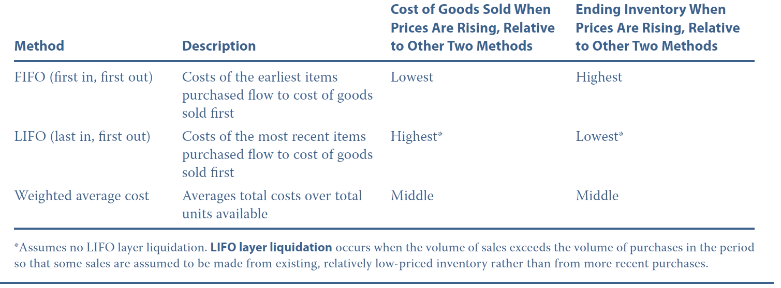
Summary table on inventory costing methods

Slide 26
MCQ n°1
During 2021, Accent Toys Plc., which began business in October of that year, purchased 10,000 units of a toy at a cost of £10 per unit in October. The toy sold well in October. In anticipation of heavy December sales, Accent purchased 5,000 additional units in November at a cost of £11 per unit. During 2021, Accent sold 12,000 units at a price of £15 per unit.
Under the first in, first out (FIFO) method, what is Accent’s cost of goods sold for 2021?
A £120,000
B £122,000
C £124,000

Slide 27
MCQ n°2
During 2021, Accent Toys Plc., which began business in October of that year, purchased 10,000 units of a toy at a cost of £10 per unit in October. The toy sold well in October. In anticipation of heavy December sales, Accent purchased 5,000 additional units in November at a cost of £11 per unit. During 2021, Accent sold 12,000 units at a price of £15 per unit.
Under weighted average cost method, what is Accent’s cost of goods sold for 2021?
A £120,000
B £122,000
C £124,000

Slide 28
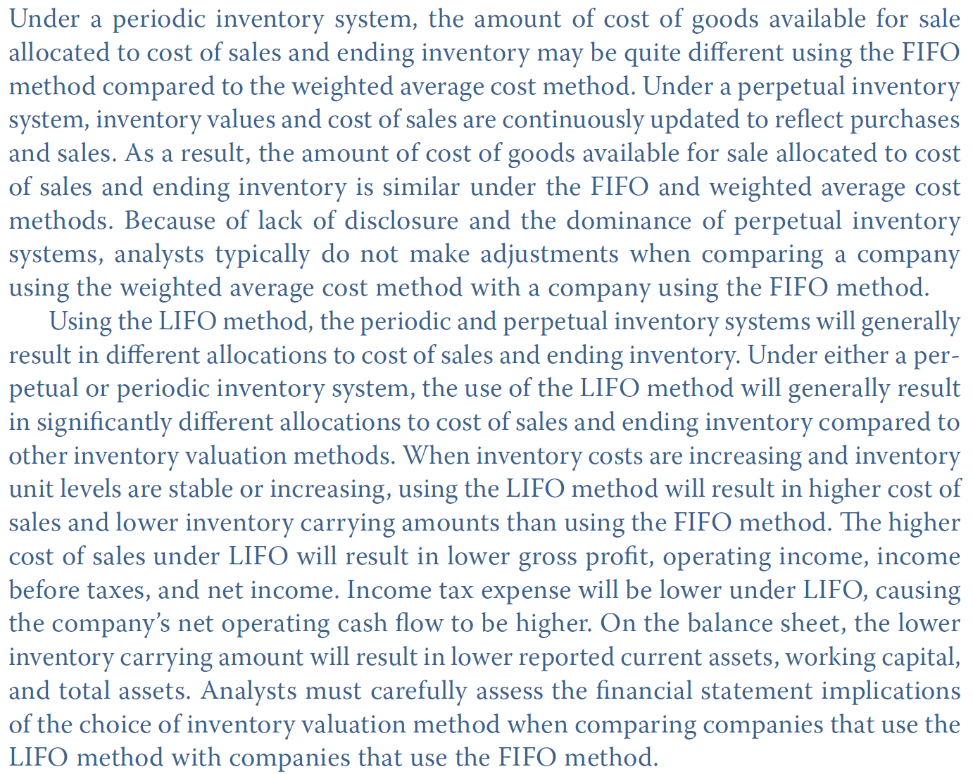

Periodic versus permanent inventory system
Inflation
$$Inventory turnover= \frac{COGS}{Average inventory}$$
LIFO rather than FIFO:
LIFO COGS > FIFO COGS
LIFO inventory < FIFO inventory
LIFO inventory turnover > FIFO inventory turnover

Slide 29
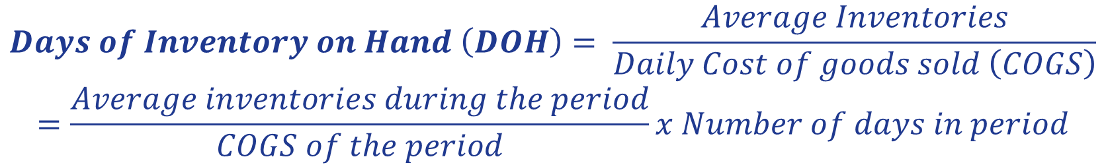
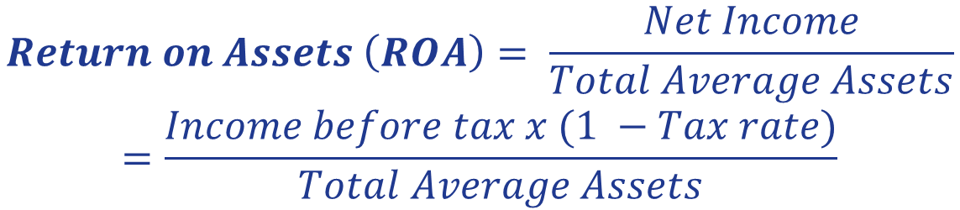
Formulas
$$Gross profit margin= \frac{Gross profit}{Revenue}=\frac{Revenue −Cost of sales}{Revenue}$$
$$Days of Inventory on Hand \left(DOH\right)= \frac{Average Inventories}{Daily Cost of goods sold \left(COGS\right)}$$
$$=\frac{Average inventories during the period}{COGS of the period}x Number of days in period$$
$$Return on Assets \left(ROA\right)= \frac{Net Income}{Total Average Assets}$$
$$=\frac{Income before tax x (1 −Tax rate)}{Total Average Assets}$$

Slide 30
Retail inventory method
Example of the Retail Inventory Method
An iPhone costs $300 to purchase (merchandise cost) and it sells for $500. The cost-to-retail ratio is 60% ($300/$500). Let's say that the iPhone had total sales of $1,800,000 for the period.
Beginning inventory: $1,000,000
New Purchases: $500,000
Total goods available for sale: $1,500,000
Cost of Sales: $1,080,000 (Sales of $1,800,000 x 60% cost-to-retail ratio)
Ending inventory: $420,000 ($1,500,000 - $1,080,000)
Initial source: www.investopedia.com
Gross profit margin = $\frac{Gross profit}{Revenue}=1 − \frac{COGS}{Revenue}=1 − \frac{Unit COGS x Sales volume}{Selling price x Sales volume}=1 −60\%=40\%$

Slide 31


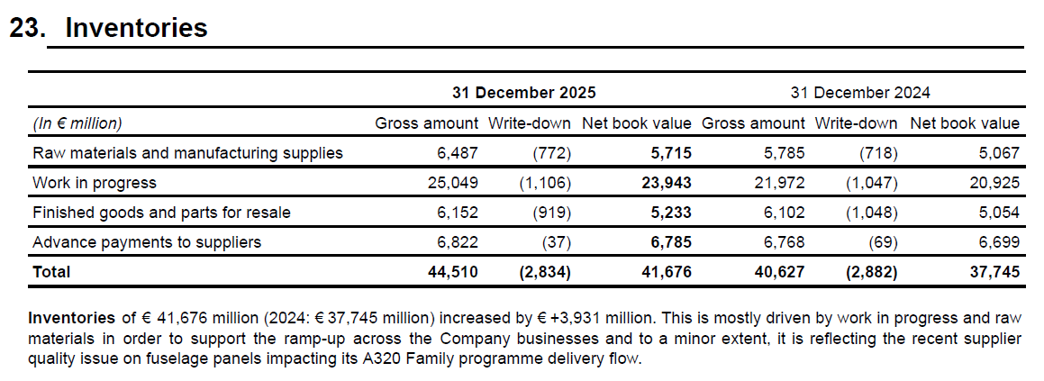
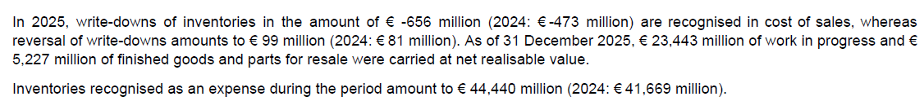
IFRS
Work in progress: aircrafts and helicopters not finished at the end of the period
Notes:
We can (see we must) impair the inventories when it becomes probable that their estimated selling price will be lower than their costs
“Net realisable value is the estimated selling price in the ordinary course of business less the estimated costs of completion and the estimated costs necessary to make the sale”.
“Inventories shall be measured at the lower of cost and net realizable value ».
Recognition of impairment if stock value > Net realisable value

Slide 32
IFRS
Work in progress: aircrafts and helicopters not finished at the end of the period
Writedown of inventories if
Unit cost in inventory > Net realizable value
Notes:
We can (see we must) impair the inventories when it becomes probable that their estimated selling price will be lower than their costs
“Net realisable value is the estimated selling price in the ordinary course of business less the estimated costs of completion and the estimated costs necessary to make the sale”.
“Inventories shall be measured at the lower of cost and net realizable value ».
Recognition of impairment if stock value > Net realisable value

Slide 33
Write-down of inventory
Under IFRS or US GAAP with FIFO and WAC methods, inventory is written down to lower of cost or NRV, and market is not in the equation
IAS 2 Inventories - § 9 : “Inventories shall be measured at the lower of cost and net realizable value” (NRV).
IAS 2 defines NRV as follows: “Net realizable value is the estimated selling price in the ordinary course of business less the estimated costs of completion and the estimated costs necessary to make the sale”
Source: IFRS and US GAAP, a comprehensive comparison, Steven E. Shamrock, Wiley, 2012
Notes:
In IFRS “Net realisable value is the estimated selling price in the ordinary course of business less the estimated costs of completion and the estimated costs necessary to make the sale”.

Slide 34
Differences between IFRS and US GAAP
 | IFRS | US GAAP
Cost flow assumption | FIFO or WAC | FIFO, LIFO or WAC
Writedown or write-off | If higher than the net realizable value | 2 situations: FIFO or WAC: higher than the net realizable value LIFO or retail inventory method: higher than the market value
Reversal | Permitted | Permitted only during the same fiscal year (than the inventory writedown)
Notes:
=> LIFO is prohibited under IFRS because LIFO cause reduction in tax burden under inflationary economies i.e. in the times of rising prices. LIFO is permitted under the US GAAP

Slide 35
Write-down of inventory
Under both IFRS and US GAAP, inventory must be assessed each period for decreases in value.
However, the standards differ with regard to the basis for the reduction and the “floor” down to which inventory can be carried.
Source: IFRS and US GAAP, a comprehensive comparison, Steven E. Shamrock, Wiley, 2012
Notes:
Floor = plancher
Toutefois, les normes diffèrent en ce qui concerne la base de la réduction et le «plancher» en bas à laquelle l'inventaire peut être effectué.

Slide 36
Write-down of inventory in US GAAP
Under US GAAP, inventory with LIFO method or retail inventory method that has lost value is written down to market otherwise (FIFO and WAC methods) is written down to net realizable value (NRV), similar to IFRS. The definition of market under US GAAP is as follows (per the ASC):
“As used in the phrase lower of cost or market, the term market means current replacement cost (by purchase or by reproduction, as the case may be) provided that it meets both of the following conditions:
a- Market shall not exceed the net realizable value
b- Market shall not be less than net realizable value reduced by an allowance for an approximately normal profit margin”
Notes:
In IFRS “Net realisable value is the estimated selling price in the ordinary course of business less the estimated costs of completion and the estimated costs necessary to make the sale”.
La valeur de marché ne doit pas
excéder la valeur nette de réalisation
Être inférieure à la valeur nette de réalisation de laquelle on déduit une provision correspondant à la marge bénéficiaire
Prix de vente – marge < coût de remplacement actuel = market< prix de vente
Net realizable value reduced by a normal profit margin < MARKET < Net realizable value
Compris entre = contained between

Slide 37
Write-down of inventory in US GAAP under LIFO method
Net realizable value (NRV) is defined in US GAAP (per the Master Glossary) as
“Estimated selling price in the ordinary course of business
less reasonably predictable costs of completion and disposal”.
Under US GAAP, the resulting cost of the reduction in inventory value must produce a normal profit margin when sold. This is done by defining boundaries for the carrying value.
US GAAP requires inventory to be carried
at the lower of cost or market,
but market cannot be greater than NRV, nor can it be less than NRV less a normal profit margin.
Source: IFRS and US GAAP, a comprehensive comparison, Steven E. Shamrock, Wiley, 2012
Notes:
In IFRS “Net realisable value is the estimated selling price in the ordinary course of business less the estimated costs of completion and the estimated costs necessary to make the sale”.
Boundaries = limites
En US GAAP, le coût résultant de la réduction de la valeur d'inventaire doit produire une marge de profit normale lorsqu'il est vendu. Cela se fait en définissant des limites pour la valeur comptable.
US GAAP exige que les stocks soient comptabilisés au minimum du coût ou de la valeur de marché, mais la valeur de marché ne peut pas être supérieure à NRV, ni ne peut être inférieure à NRV moins une marge bénéficiaire normale.

Slide 38
Write-down of inventory in US GAAP under LIFO method and retail inventory method
Ceiling: Net realizable value (NRV)
Historical cost
Market value = replacement cost
Minimum between
and
Floor: Net realizable value minus normal profit
Source: IFRS and US GAAP, a comprehensive comparison, Steven E. Shamrock, Wiley, 2012
Notes:
Ceiling = plafond
Floor = plancher
NRV = Estimated selling price less reasonably predictable costs of completion and disposal

Slide 39
Write-down of inventory
Under IFRS or US GAAP with FIFO and WAC methods, inventory is written down to lower of cost or NRV, and market is not in the equation
IAS 2 Inventories - § 9 : “Inventories shall be measured at the lower of cost and net realizable value” (NRV).
IAS 2 defines NRV as follows: “Net realizable value is the estimated selling price in the ordinary course of business less the estimated costs of completion and the estimated costs necessary to make the sale”
Source: IFRS and US GAAP, a comprehensive comparison, Steven E. Shamrock, Wiley, 2012
Notes:
In IFRS “Net realisable value is the estimated selling price in the ordinary course of business less the estimated costs of completion and the estimated costs necessary to make the sale”.

Slide 40
Examples US GAAP versus IFRS
Example 1 with LIFO method or retail inventory method under US GAAP
Carrying value | $ 100
Replacement cost | 90
Net realizable value | 95
Net realizable value less normal profit margin | 80
Inventory would be recorded at
$90 under U.S GAAP with LIFO (write-down of 10 is required) and
$95 under IFRS (a write-down of 5 is required).
Example 2
Inventory would be recorded at
Carrying value | $ 100
Replacement cost | 90
Net realizable value | 105
Net realizable value less normal profit margin | 95
$95 under U.S GAAP with LIFO (a write-down of 5 is required)
and
$100 under IFRS (i.e., no write-down is required).
Notes:
US GAAP : 1) lower of cost or market (market = replacement cost),
2) NRV – normal profit margin < market = replacement cost< NRV
IFRS : lower cost or NRV
Examples:
the replacement cost shall not exceed the NRV
the replacement cost shall not be lower than NRV less normal profit margin
The inventory will be recorded for which amount according US GAAP ?
The inventory will be recorded for which amount according IFRS ?

Slide 41
Write-down of inventory: example of an old model of smartphone after the launching of a new model
Selling price | Historical cost | Replacement cost (market) | Net realizable value (NRV) | NRV less normal profit
 |  |  | Ceiling | floor
$200 | $100 | $180.00
$150 | $100 | $90.00
$120 | $100 | $80.00
$90 | $100 | $80.00
$160.00
$130.00
$120.00
$97.50
$96.00
$78.00
$72.00
$58.50
Value compared with historical cost under US GAAP (with LIFO or retail inventory method)
Notes:
NRV = estimated selling price less reasonably predictable costs of completion and disposal
NRV less normal profit = estimated selling price less reasonably predictable costs of completion and disposal, less normal profit margin
NRV = selling price – S,G,A expenses (20% of sales) => 200 – 20% x 200 = 160
NRV – normal profit = NRV – profit margin (15% of sales) => 160 – 15% x 200 = 130
NRV = selling price – S,G,A expenses (20% of sales) => 150 – 20% x 150 = 120
NRV – normal profit = NRV – profit margin (15% of sales) => 120 – 15% x 150 = 97,5
NRV = selling price – S,G,A expenses (20% of sales) => 120 – 20% x 120 = 96
NRV – normal profit = NRV – profit margin (15% of sales) => 96 – 15% x 120 = 78
NRV = selling price – S,G,A expenses (20% of sales) => 90 – 20% x 90 = 72
NRV – normal profit = NRV – profit margin (15% of sales) => 72 – 15% x 90 = 58,5
Ceiling : plafond
The replacement cost shall not exceed the NRV
The replacement cost shall not be lower than NRV less normal profit margin

Slide 42
Write-down of inventory: example of an old model of smartphone after the launching of a new model
Selling price | Historical cost | US GAAP (with LIFO method) | IFRS | Effect on the expenses (in the P&L)
 |  | Market value retained | NRV | US GAAP (with LIFO) | IFRS
$200 | $100 | $160 | $160
$150 | $100 | $97.5 | $120
$120 | $100 | $80 | $96
$90 | $100 | $72 | $72
$0
$0
$2.5
$0
$20
$4
$28
$28
Expense (per unit) = Historical cost
– New carrying value

Slide 43
Write-down reversals under US GAAP and IFRS
Under IFRS, write-downs of inventory can be reversed when market conditions improve.
Under US GAAP, write-downs can be reversed only if it is within the same fiscal year.
This disparity with regard to write-down reversals is indicative of IFRS learning more towards relevance than reliability.
In fact, P,P&E and financial instrument impairments can be restored under IFRS, whereas none are able to be written back under US GAAP.
Source: IFRS and US GAAP, a comprehensive comparison, Steven E. Shamrock, Wiley, 2012
Notes:
Cette disparité en matière de dépréciation des inversions montre que les IFRS en apprennent plus sur la pertinence que la fiabilité.
En fait, les dépréciations des P, P & E et des instruments financiers peuvent être restaurés en vertu des IFRS, alors qu'aucun sont en mesure d'être repris en US GAAP.

Slide 44
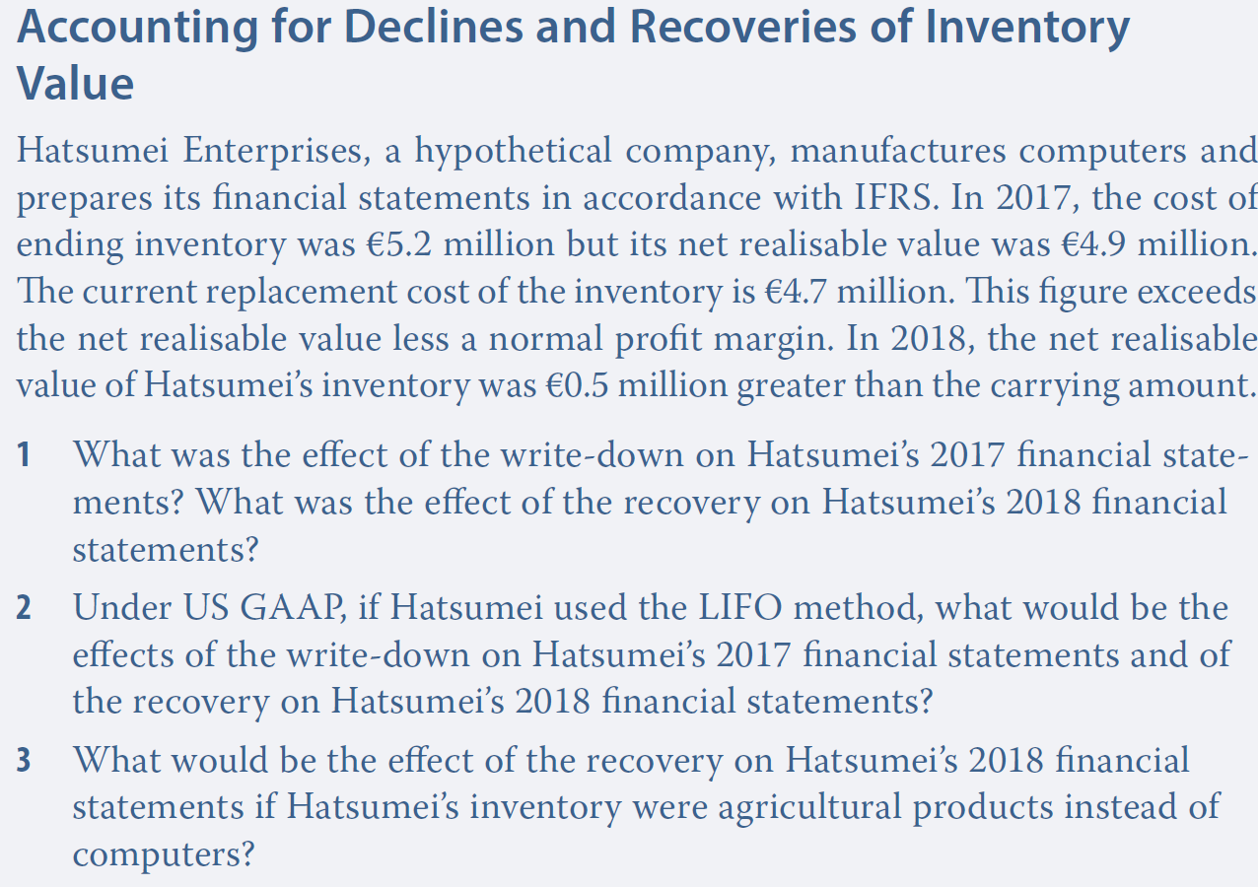
Example

Slide 45
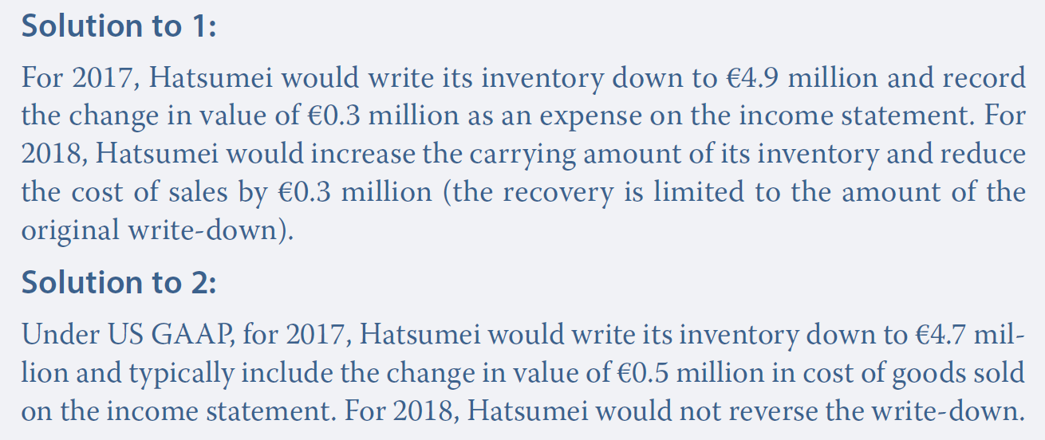
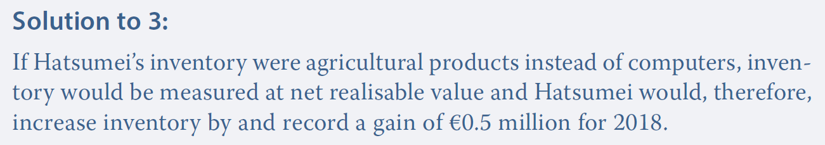
Example

